Slide 1
Large Language Models
Dr. Jawwad A Shamsi

Slide 2
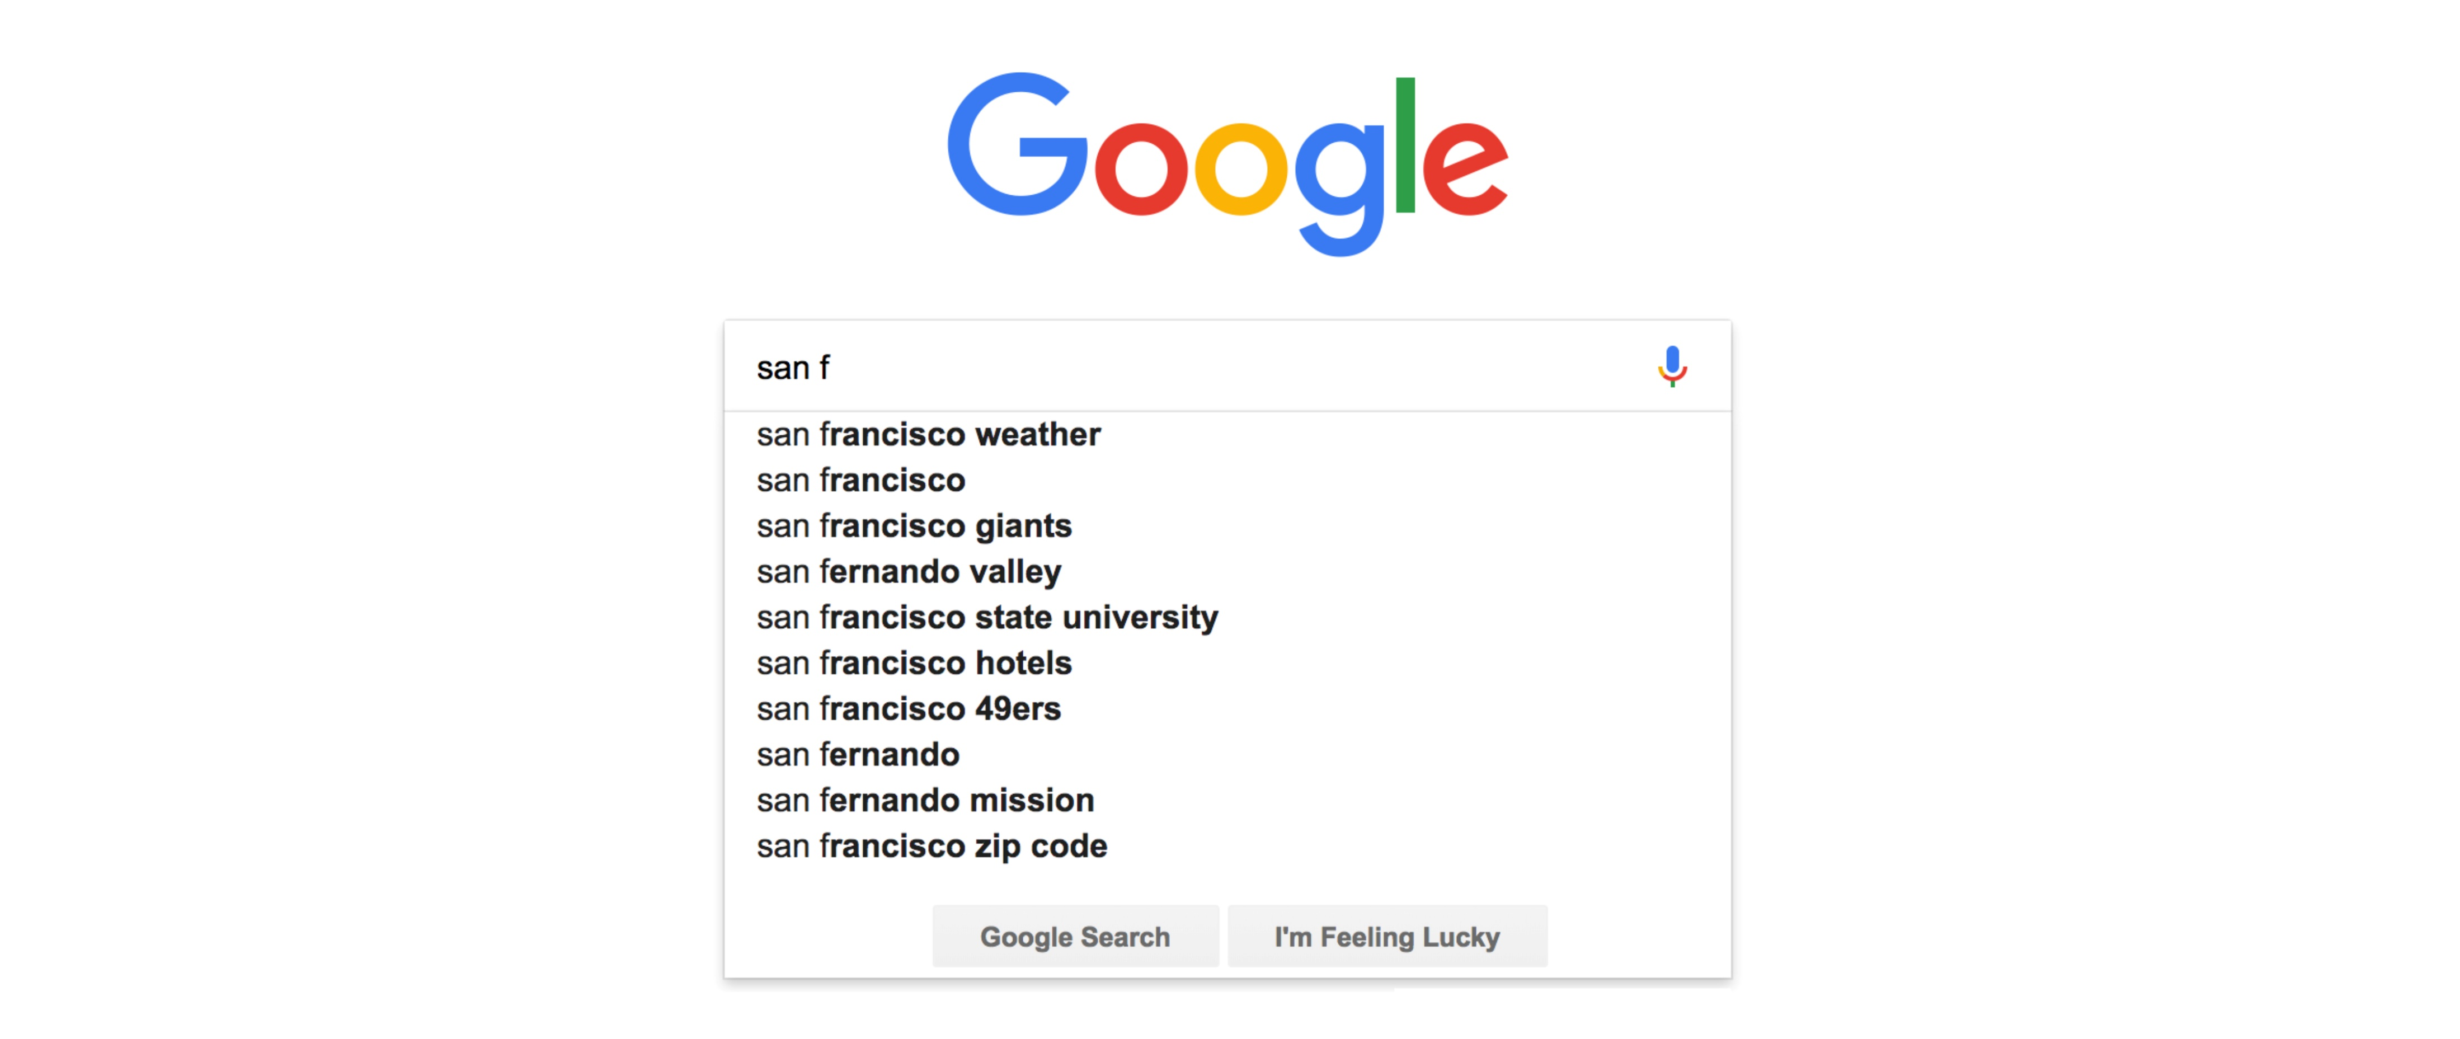
Auto Complete Feature?

Slide 3

Use Word Frequencies
To Predict the occurrence of a word
Given the word “San f”
What is the likelihood of the remaining word and the next word

Slide 4
Problem
What about new sentences?
We won the world cup in 2024
We have billions of new sentences

Slide 5
We need to do more than just counting sentences that already exist
There are 100,000 words in a sentence and
10 words in a sentence

Slide 6
Sample Sentences
I like playing cricket. Yesterday, I had a cricket game. However, I didn’t do well.

Slide 7
Dependencies of Words
I -> like -> playing -> cricket. -> Yesterday, -> I -> had -> a -> cricket -> game. -> However, -> I -> didn’t -> do -> well.

Slide 8
Dependencies of Words
I -> like -> playing -> cricket. -> Yesterday, -> I -> had -> a -> cricket -> game. -> However, -> I -> didn’t -> do -> well.

Slide 9


Dependencies of Words
We have turned a sentence into a graph
I -> like -> playing -> cricket. -> Yesterday, However, -

Slide 10
Dependencies of Words
I -> like -> playing -> cricket. -> Yesterday, However, -
Adding Probabilities will turn this graph into a language model
0.33
0.33
0.33
We can do the same for the word ‘cricket’

Slide 11
Unseen Sentence

Slide 12
Make it Better
Provide lots of data

Slide 13
Limitation
Simplistic
Assumes each word is dependent only on a single word.
Make it conditional probability
P(X|X_{n-1})

Slide 14
Considerations
Use bi-grams
2-words together
Tri-grams
3 words together

Slide 15
Long range dependencies
I know three little boys
They have some little toys

Slide 16
What we need
P(X|X_{n-1,} X_{n-2,} X_{n-3,} X_{n-4,} X_{n-5,} X_{n-6,} X_{n-7,} X_{n-8,} X_{n-9,} X_{n-10,} X_{n-11,} X_{n-12} )

Slide 17
Problem
Exceedingly complex
Can we approximate?

Slide 18
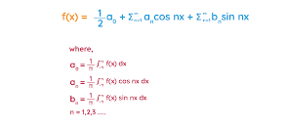
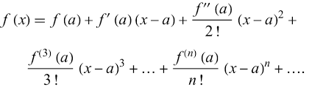
Approximation
Fourier Series
Taylor Series

Slide 19

Neural Network based approximation
No need to know about function
Just input and output pairs

Slide 20
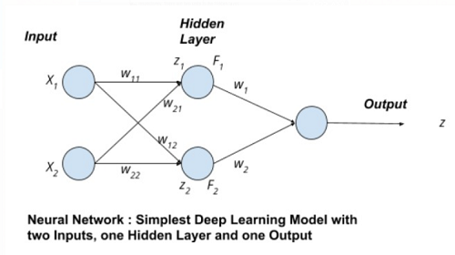
Neural Network
Two inputs and one output
Four weights
Randomize weights to predict output
Compute Error (Estimated output – Actual Output)
Compute gradient w.r.t four weights
Adjust weights
Go to 4

Slide 21
Neural Network
Approximate
Language Model

Slide 22
Given a sentence
Predict the last word
I know three little boys
They have some little toys

Slide 23
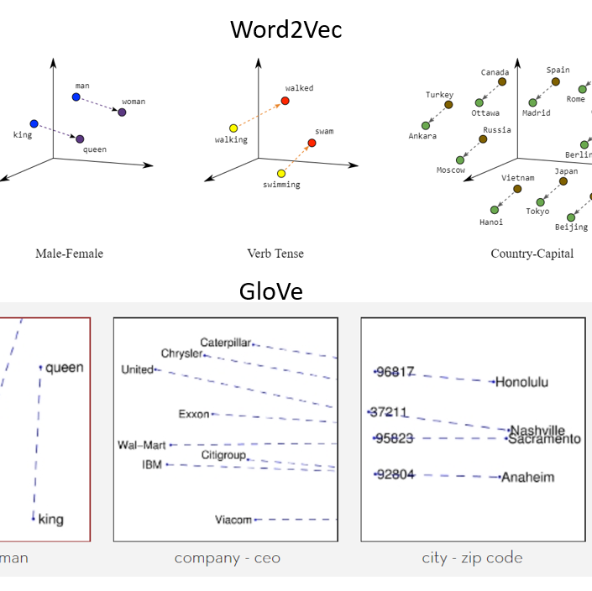
Step 1
Embeddings
Map words to numbers
Semantic mapping is needed
Use word Embeddings

Slide 24
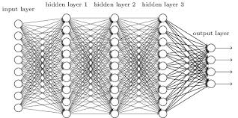
Use an MLP
Input the whole sentence
Predict the last word
This will not work because of complexity

Slide 25
Need attention
I know three little boys
They have some little toys
The network can focus on the blue colored words to predict the last word

Slide 26
toys
Combine Attention model with the predictor
For improved training, the words in blue needs to have right Attention weights
Next Word Predictor
Attention
little
boys
They
have
have
some
little

Slide 27
Use Transformer
toys
Context Vector
Sum of attention weights
Each word has a different context vector
Next Word Predictor
Attention
little
boys
They
have
have
some
little

Slide 28
Context Vector for every word
Sent to ‘Next word Predictor’ along with original word
toys
Next Word Predictor
Attention
little
boys
They
have
have
some
little

Slide 29
Stacked Models
Next Word Predictor
Stack number of layers
GPT-3 has 96
Palm (from Google) has 118
Attention
Next Word Predictor
Attention
little
boys
They
have
have
some
little

Slide 30
Stacked Models
Next Word Predictor
Billions of Parameters
Stacking Higher level reasoning
Complex relationships
Lower layers
World relationships
synatx
Attention
Next Word Predictor
Attention
little
boys
They
have
have
some
little

Slide 31
How to train
Use large text
Books
Training time?
Transformers in Parallel

Slide 32
Language Models
Are not perfect
Have some errors
Suffer from bias and stereotyping

Slide 33
Conclusion

